Slide 1



ATI
Tweet Sentiment
PHRASE EXTRACTION
Project 4
GROUP 15
HỒ VIẾT VĨNH
TRỊNH MINH ANH
NGUYỄN THÀNH TÂM

Slide 2



TABLE OF
CONTENTS
Problem Definition
Input–Output Identification
Data Preparation
Optimization Techniques
Model Architecture and Training
Performance Evaluation
Inference on New Data
Conclusion
ATI

Slide 3
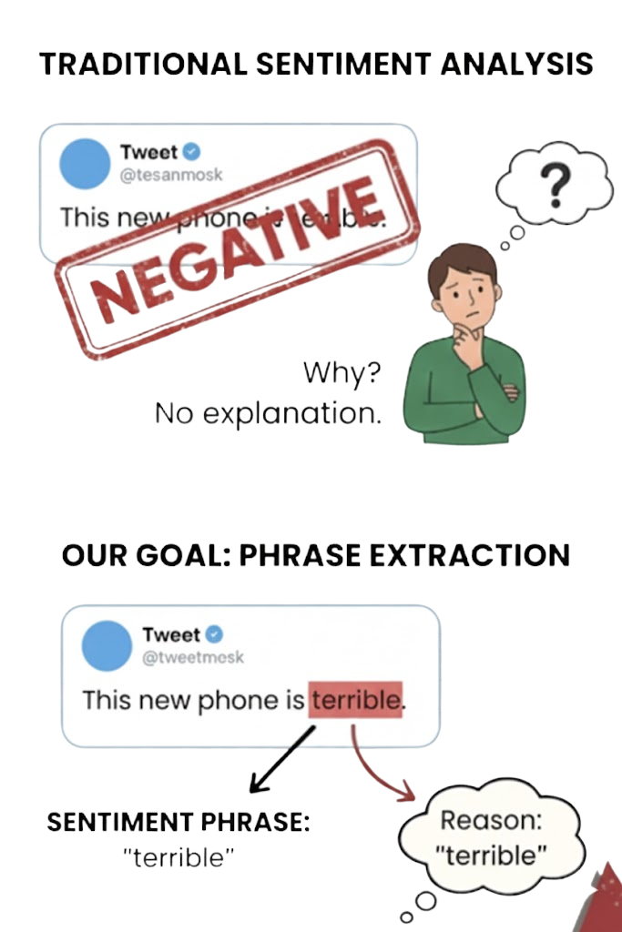


PROBLEM DEFINITION
PROBLEM:
Traditional Sentiment Analysis only tells us if a review is Positive or Negative. It fails to explain why.
OUR GOAL:
Identify the exact phrase in the tweet that supports the sentiment
CORE CONCEPT - EXTRACTIVE QA:
We treat this as a Question-Answering task:
Context: The Tweet text.
Question: "What part of this text is [Positive/Negative]?"
Answer: The start and end positions of the phrase.
ATI

Slide 4
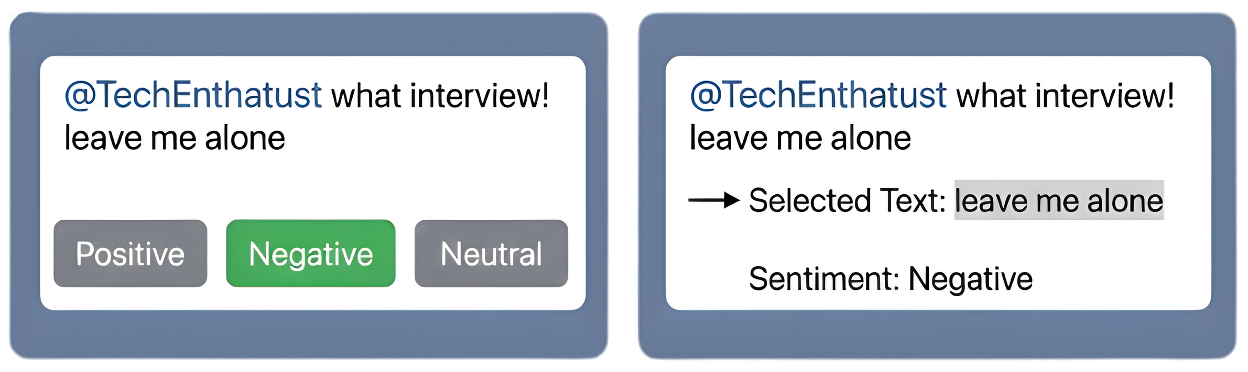

ATI
INPUT–OUTPUT IDENTIFICATION
INPUT:
A dataset where:
OUTPUT:
text: the raw tweet text
sentiment: sentiment label (positive, negative, neutral)
selected_text: a substring extracted from text that best represents the given sentiment

Slide 5
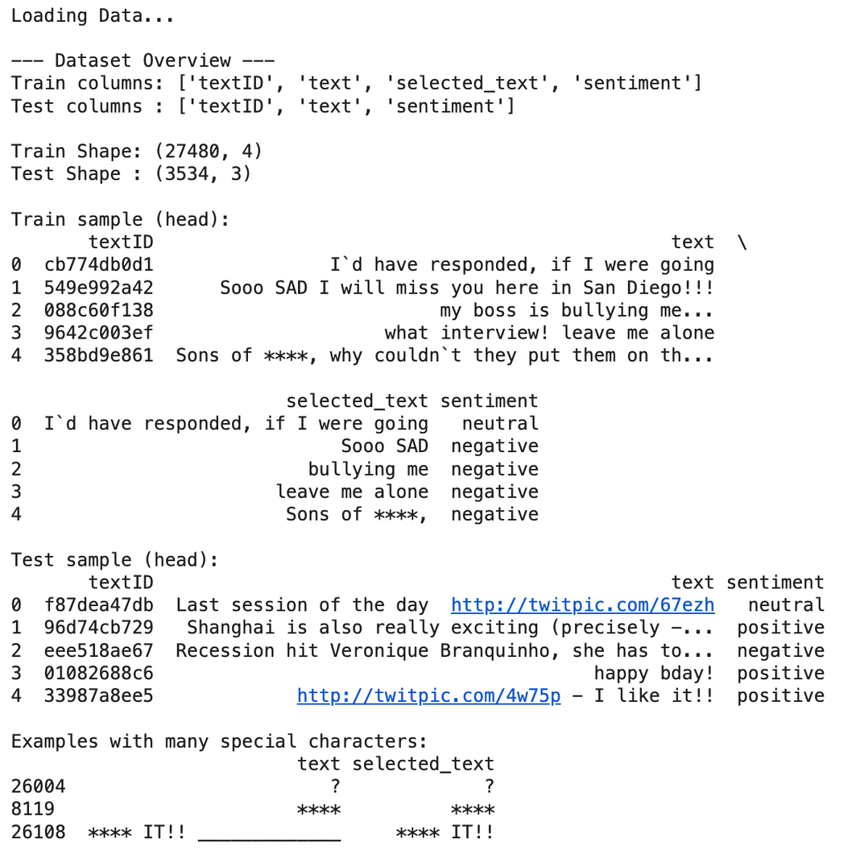
ATI
Data Preparation
Inspecting data:
Train (train.csv) - shape: (27480, 4):
Columns: textID, text, selected_text, sentiment
selected_text is the annotated phrase (target span) that justifies the sentiment label.
Test (test.csv) - shape: (3534, 3):
Columns: textID, text, selected_text
Test set does not contain selected_text ( reserved for inference/prediction).

Slide 6
ATI
Data Preparation
Inspecting data:
Key observations
selected_text represents an extractive span from text
data is noisy: URLs, many special characters / punctuation, abbreviations and informal tokens appear frequently.
→ robust preprocessing and an advanced tokenizer (BPE) to avoid "Unknown Token" ([UNK]) issues.

Slide 7
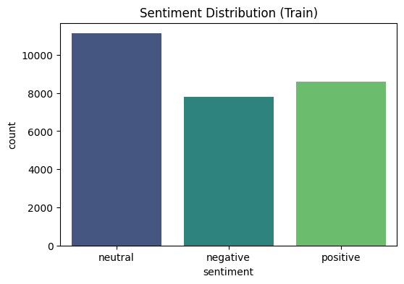
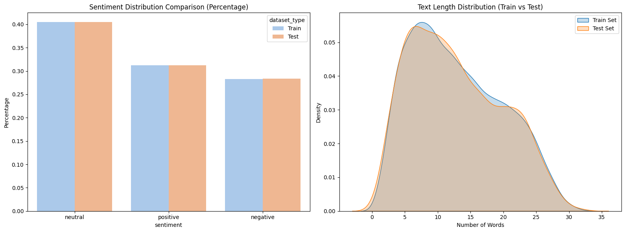
Data Preparation
Visualizing data:
ATI

Slide 8
Data Preparation
Visualizing data:
Label Distribution:
Imbalanced: Neutral (~40%) dominates, followed by Positive (~31%) and Negative (~29%).
Text Length:
Most tweets < 64 words; token count is higher with RoBERTa (Byte-Level BPE)
MAX_LEN = 96 or 128 is appropriate
ATI

Slide 9
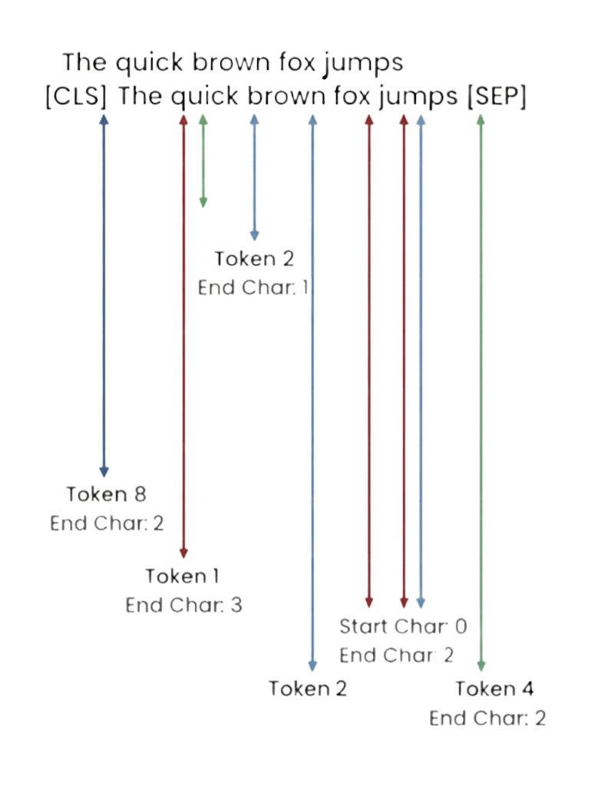

ATI
Data Preparation
Data Pre-processing:
The Alignment Problem:
Humans select text by characters
Models read tokens (sub-words)
Converting between them causes errors.
Solution: Robust Offset Mapping
Definition: Maps each token ID to its exact character span in the raw text.
Benefit: Ensures accurate character highlighting when the model predicts a specific token (e.g., Token #5).

Slide 10
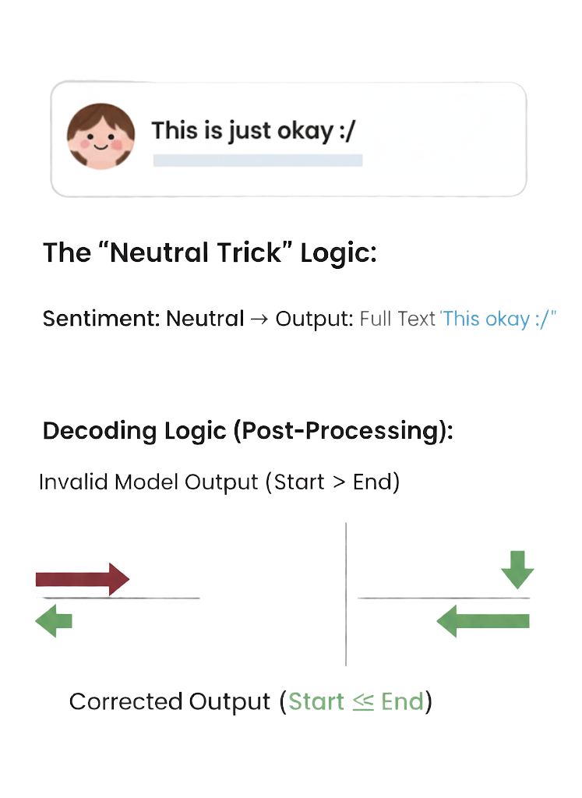
ATI
4. OPTIMIZATION TECHNIQUES
The "Neutral Trick" (Heuristic Rule)
Observation: In 99% of cases, if a tweet is "Neutral", the entire text is the answer.
Action: We force the model: If Sentiment == Neutral -> Output = Full Text.
Result: Drastically improves accuracy for the Neutral class.
Decoding Logic
The model might predict an End index before a Start index (invalid)
→ Post-processing fixes these logical errors to ensure a valid text span.

Slide 11
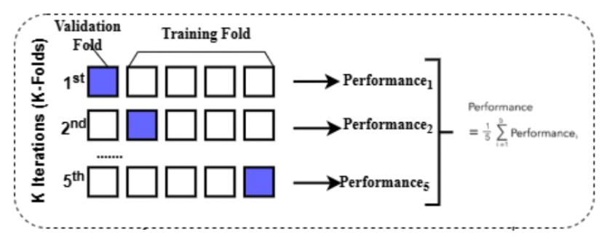
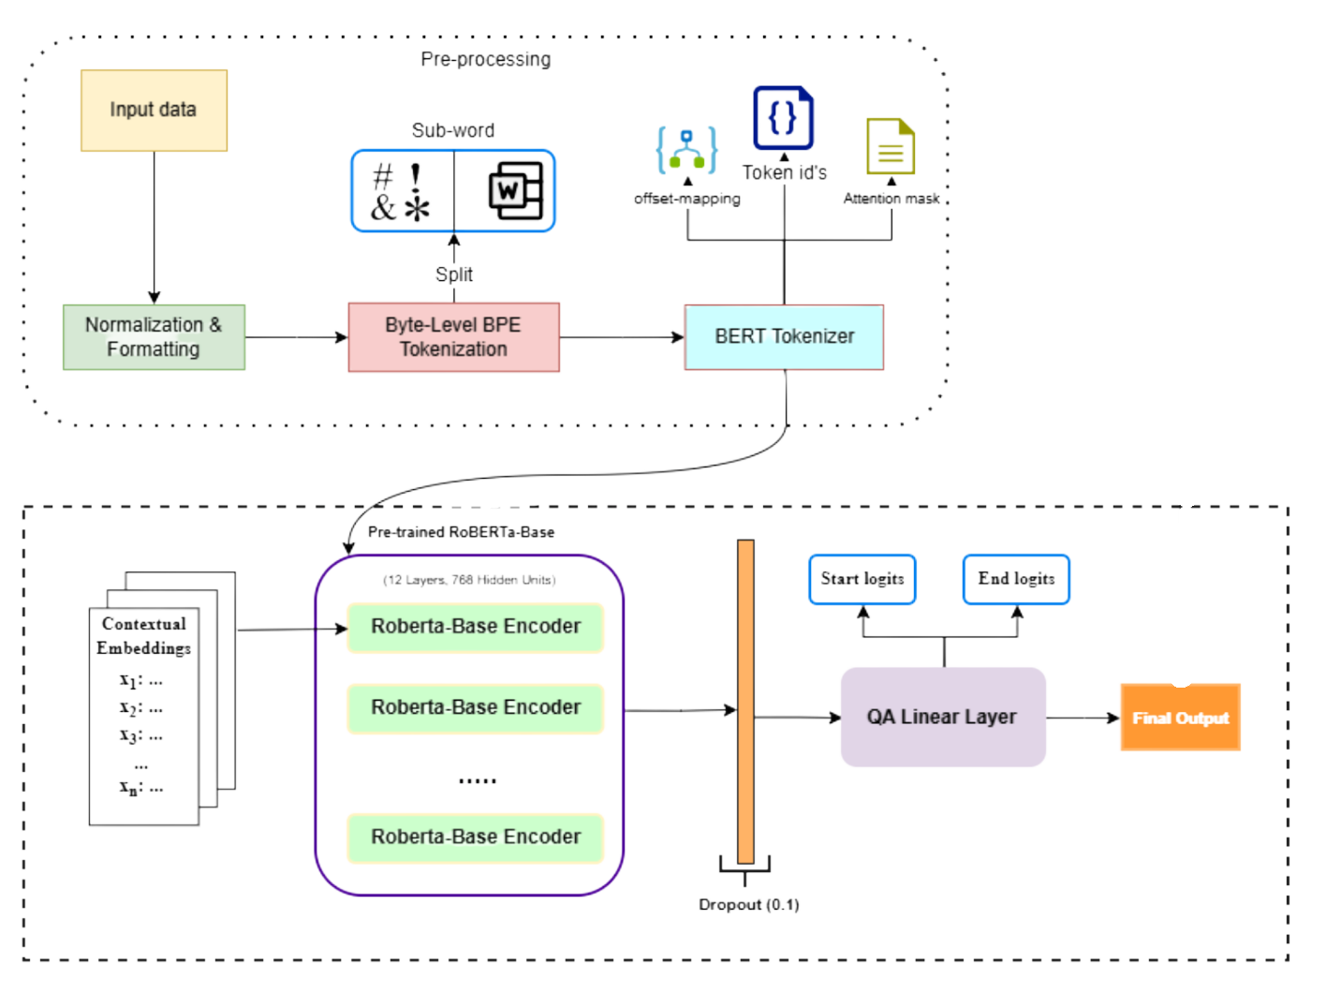
ATI
5.MODEL ARCHITECTURE & TRAINING
WHY ROBERTA?

Slide 12
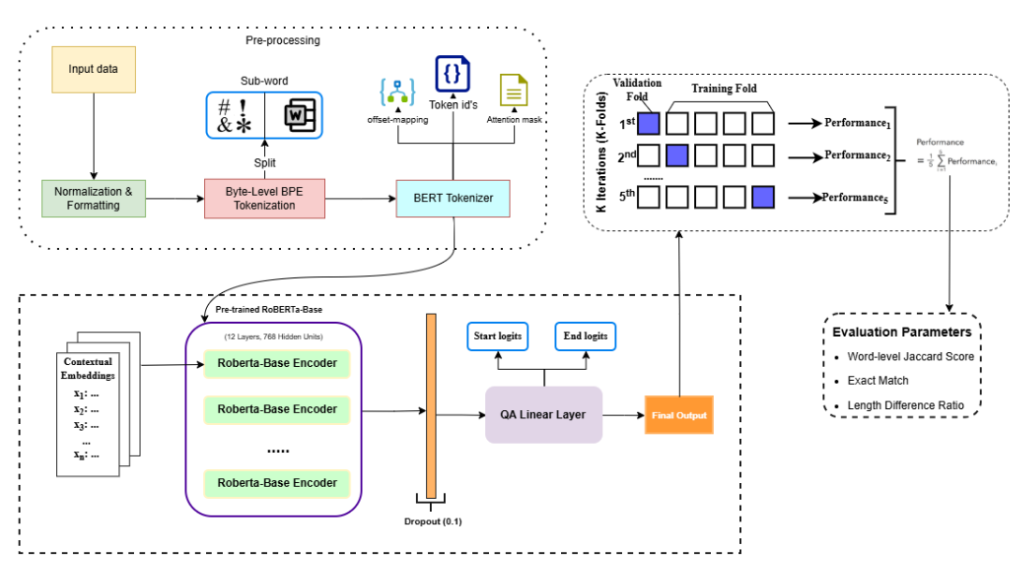
ATI
5.MODEL ARCHITECTURE & TRAINING

Slide 13
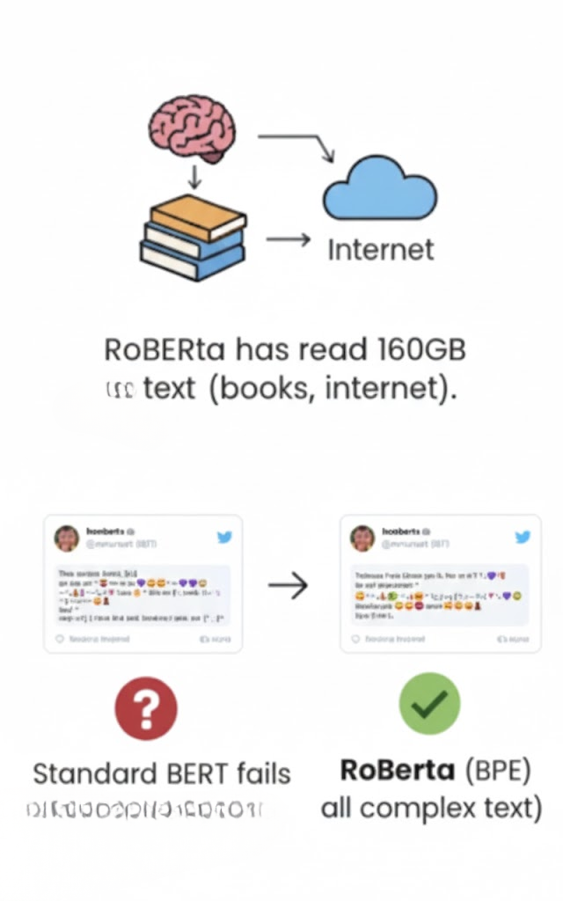

MODEL ARCHITECTURE & TRAINING
WHY ROBERTA?
MODEL:
RoBERTa ≥ standard BERT
KEY CONCEPT - PRE-TRAINING:
RoBERTa has read 160GB of text (books, internet) before we even started, giving it "general knowledge."
WHY IT WORKS FOR TWEETS:
Data: Trained on 10x more data than BERT.
Tokenization (Byte-Level BPE): Crucial.
Standard models fail on emojis or weird characters (marking them as [UNK] - Unknown).
RoBERTa breaks words down into bytes/characters
→ it can read any complex text found on Twitter without errors.
ATI

Slide 14
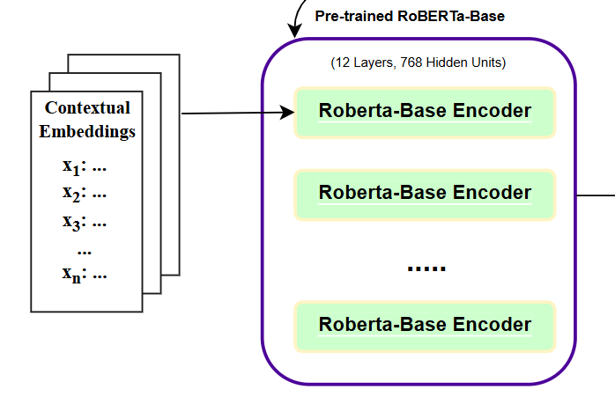
MODEL ARCHITECTURE & TRAINING
CONTEXTUAL EMBEDDINGS
After the tokenizer step, each tweet is converted into a sequence of token IDs.
Each token is no longer a discrete number but becomes a contextual embedding vector
This vector depends on the surrounding context, not static meaning.
Eg: "I am sooo happy today!"
After Byte-Level BPE: ["I", "am", "so", "oo", "happy", "today", "!"]
RoBERTa Encoder
x1 = embedding("I", context)
x2 = embedding("am", context)
x3 = embedding("so", context)
...
ATI

Slide 15
5. MODEL ARCHITECTURE & TRAINING
Architecture
How Start Logits & End Logits work:
RoBERTa-Base (Backbone) + Linear Layer (QA Head).
Explanation: The Linear Layer acts as a pointer, predicting two numbers: Probability of being the Start word and Probability of being the End word.
Eg: "Sooo SAD I will miss you"
Token [0] Sooo: start logits: 0.1 | end logits: 0.2
Token [1] SAD: start logits: 4.5 | end logits: 3.9
Token [2] I: start logits: 0.2 | end logits: 0.3
...
→ Result: Token index 1 (“SAD”) has the highest start logit and highest end logit.
ATI

Slide 16
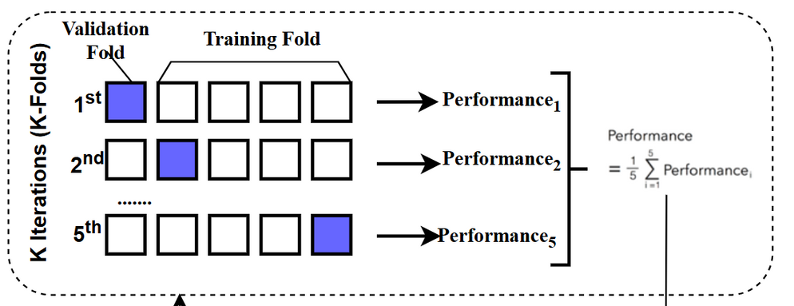
5. MODEL ARCHITECTURE & TRAINING
Training Strategy (Resource-Optimized):
Stratified Split: Data is split ensuring balanced sentiments.
Representative Fold Training: Due to computational limits, we employed a 5-fold validation
Safeguard: We save the "Best Model" based on Validation Jaccard to prevent overfitting.
→ To increase stability and reduce variance, we use 5-Fold Cross-Validation.

Slide 17
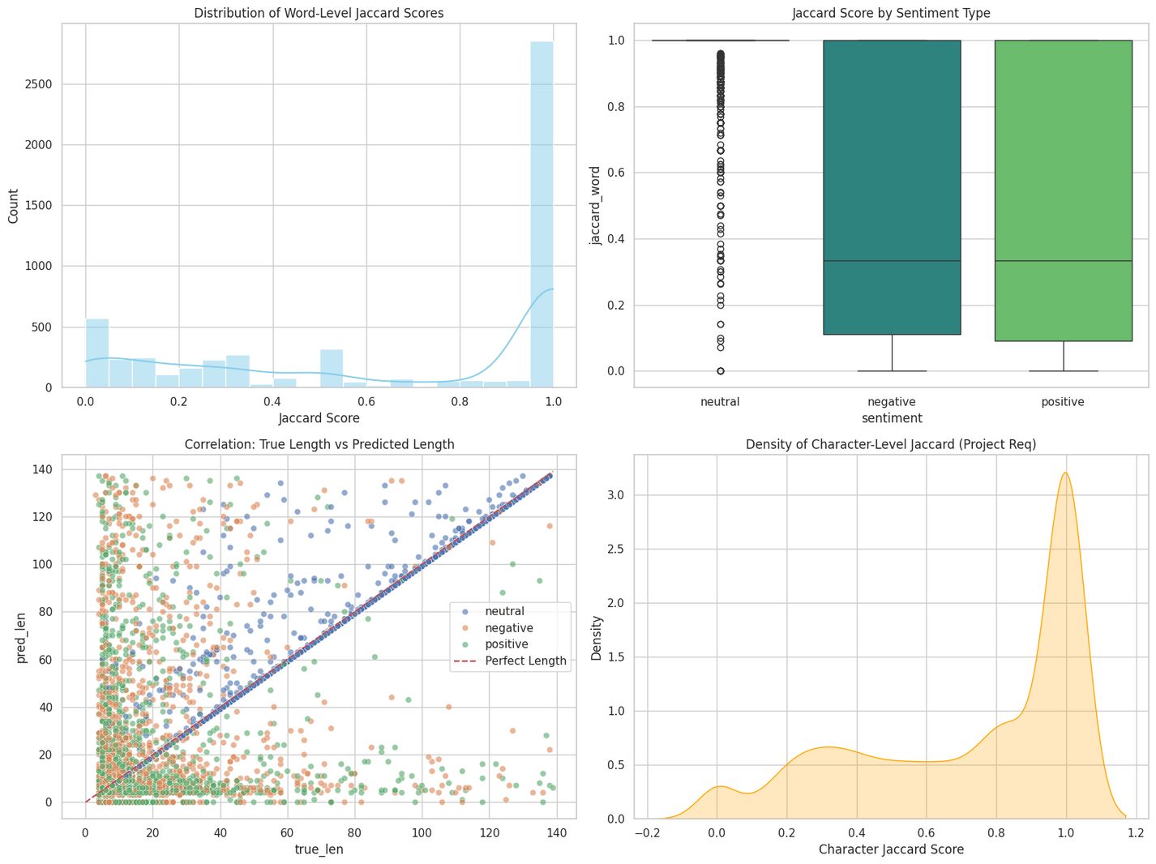
ATI
6.
EXPERIMENTAL RESULTS

Slide 18
VISUAL ANALYSIS
Jaccard Distribution: A massive peak at 1.0.
→ most tweets (especially Neutrals), model retrieves the phrase perfectly.
Sentiment Breakdown:
Neutral: Extremely high performance (Median ≈ 1.0) due to the optimization trick.
Positive/Negative: The model effectively captures subjective phrases, though with slightly more variance as these are harder to define.
Length Correlation: The predicted length closely follows the true length (diagonal line), proving the model understands boundaries well.
ATI

Slide 19
ATI
FINAL SCORE
Our optimized model achieves a Jaccard Score of ~0.705, surpassing the baseline (~0.68).

Slide 20
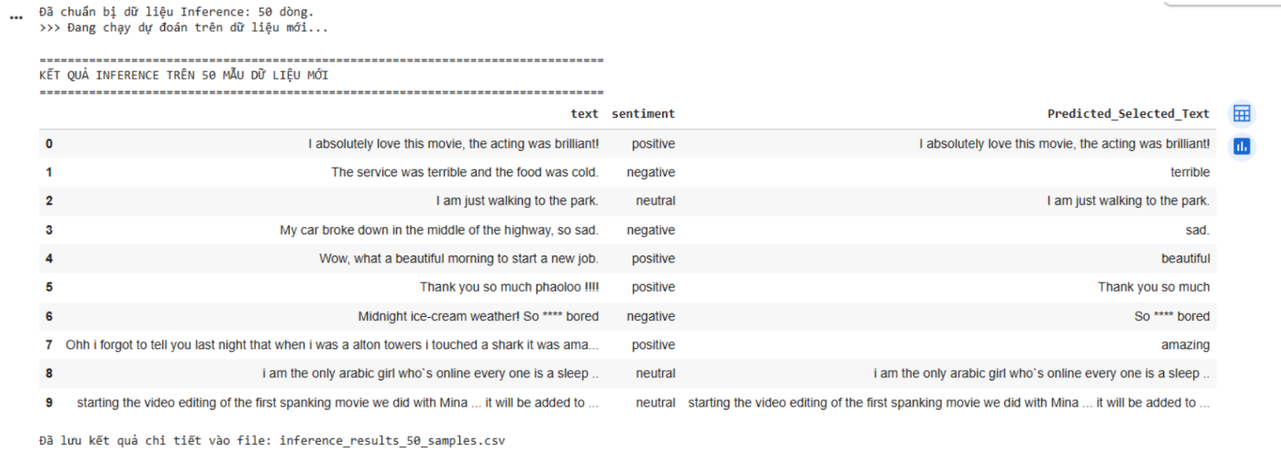
7. INFERENCE ON NEW DATA
ATI
New Data for Inference:
5 Manual Inputs + 45 Random Test Samples (test.csv)

Slide 21
7. INFERENCE ON NEW DATA
ATI
Neutral label
Negative label
Positive label
Output: selects the entire sentence
→ correct (no emotion-bearing keyword), model has learned this rule accurately
Output: extracts the key negative token (precise, not the full sentence)
Output: correctly identifies the positive adjective

Slide 22
7. INFERENCE ON NEW DATA
ATI
Strengths
Summary
Accurately classifies sentiment and pinpoints key phrases
Correctly applies dataset rule for Neutral - selects the full sentence.
RoBERTa learned text semantics well - strong performance in training and real-world inference.

Slide 23
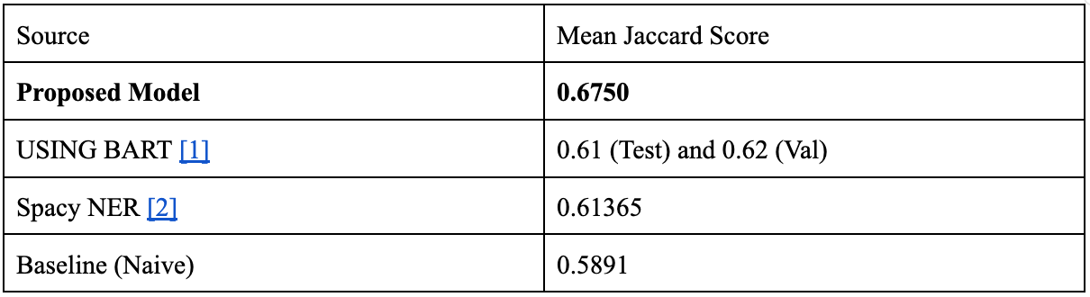
8. CONCLUSION
ATI
Overall Performance:
The proposed model achieves 0.6750 Jaccard, significantly outperforming prior studies (~0.61–0.62)
In NLP competitions (e.g., Kaggle Tweet Sentiment Extraction), a +0.05–0.06 Jaccard gain represents a major performance leap.
[1] https://ijsret.com/wp-content/uploads/2024/05/IJSRET_V10_issue3_130.pdf
[2] https://arxiv.org/pdf/2403.14050

Slide 24
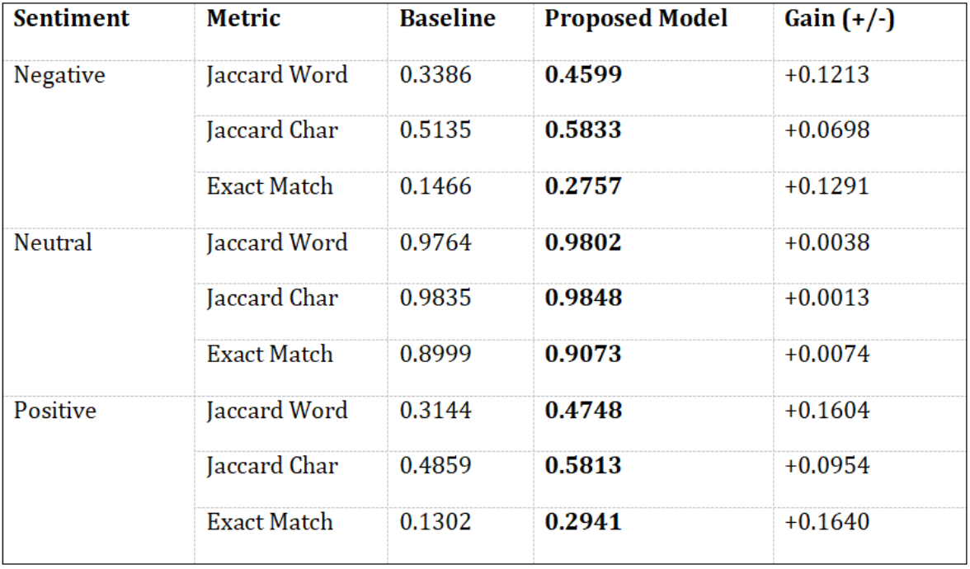
8. CONCLUSION
ATI
Learning Capability:
Strong improvements on Positive and Negative samples (+35%–51% vs. baseline)
→ effective sentiment phrase extraction > full-sentence prediction
Exact Match (Positive) more than doubled (13% → 29%)
→ substantially higher precision

Slide 25
8. CONCLUSION
ATI
Stability:
Neutral performance remains high and slightly improved (0.9802 vs. 0.9764), showing no catastrophic forgetting on simple cases.

Slide 26
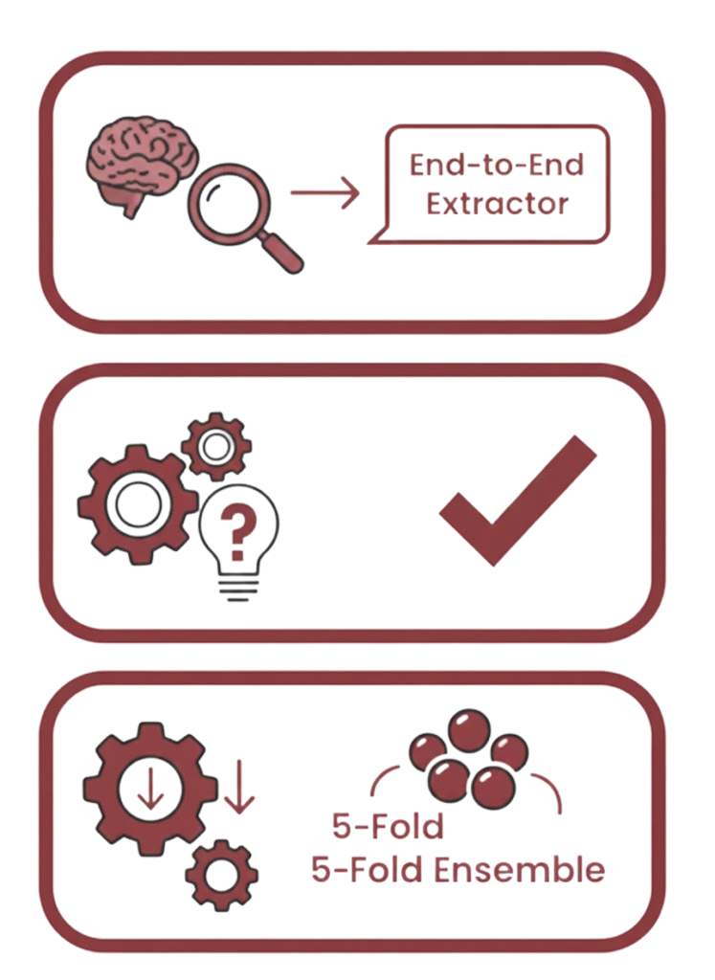
ATI
8. CONCLUSION
Summary:
Built an End-to-End system transforming RoBERTa from a classifier inato an extractor.
Key Takeaway:
Correctly framing the problem as "Question Answering" and applying domain-specific rules (Neutral Trick) is more effective than just making the model larger.
Future Work:
Explore Model Distillation (making the model smaller/faster) and full 5-Fold Ensemble when resources permit.

Slide 27
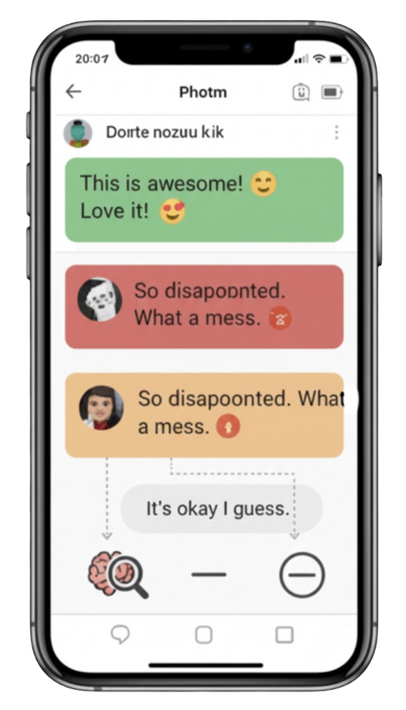
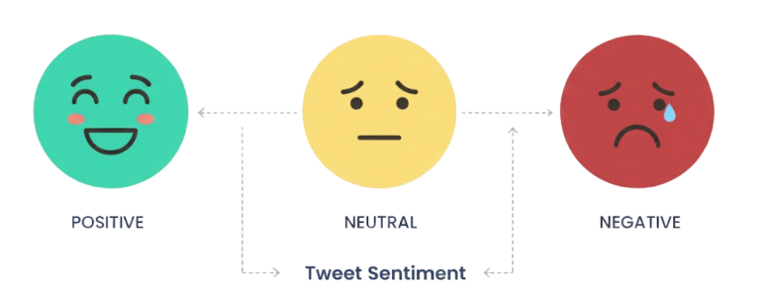
ATI
THANK YOU
FOR LISTENING

